Slide 1
One dim. fitting with higher order polynomials
Group meeting 21.08.24
Notes:
Very important: here log10 was seen as log in code, so everything is wrong

Slide 2
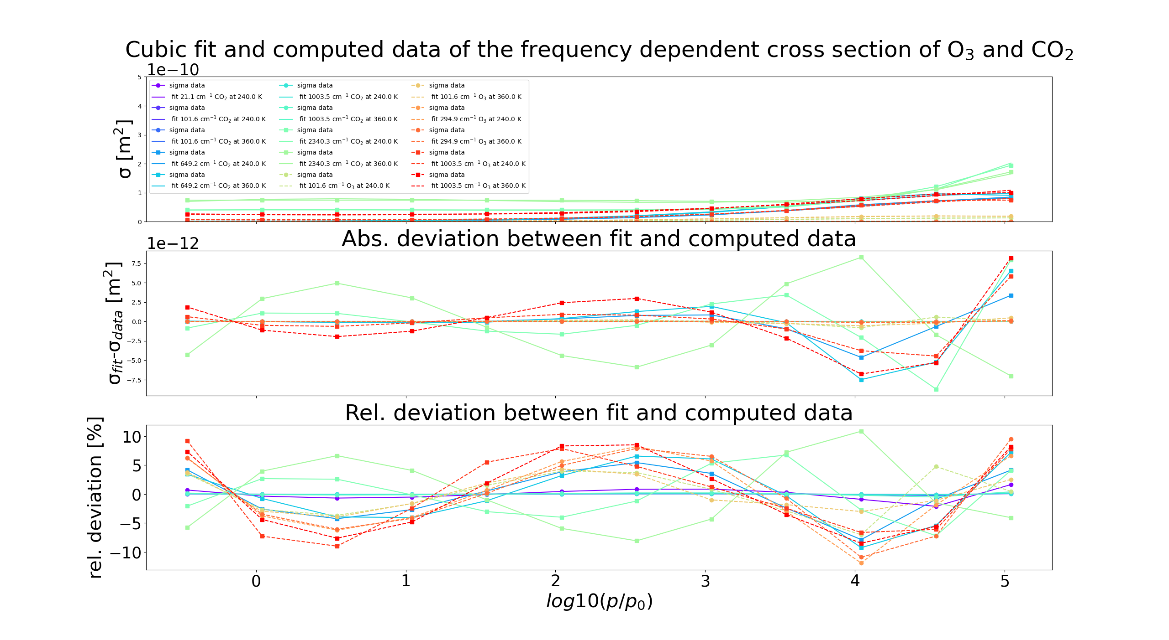
Cumulative cubic fitting with deviations for cross sections
all fits of ln(sigma) are plotted in same figure
Derived deviations fit-data for cross section additonally plotted
Design improved
Notes:
example for improved design: fit at frequencies at peak or wing of peak with square, far away of absorption peaks with circle plottted

Slide 3
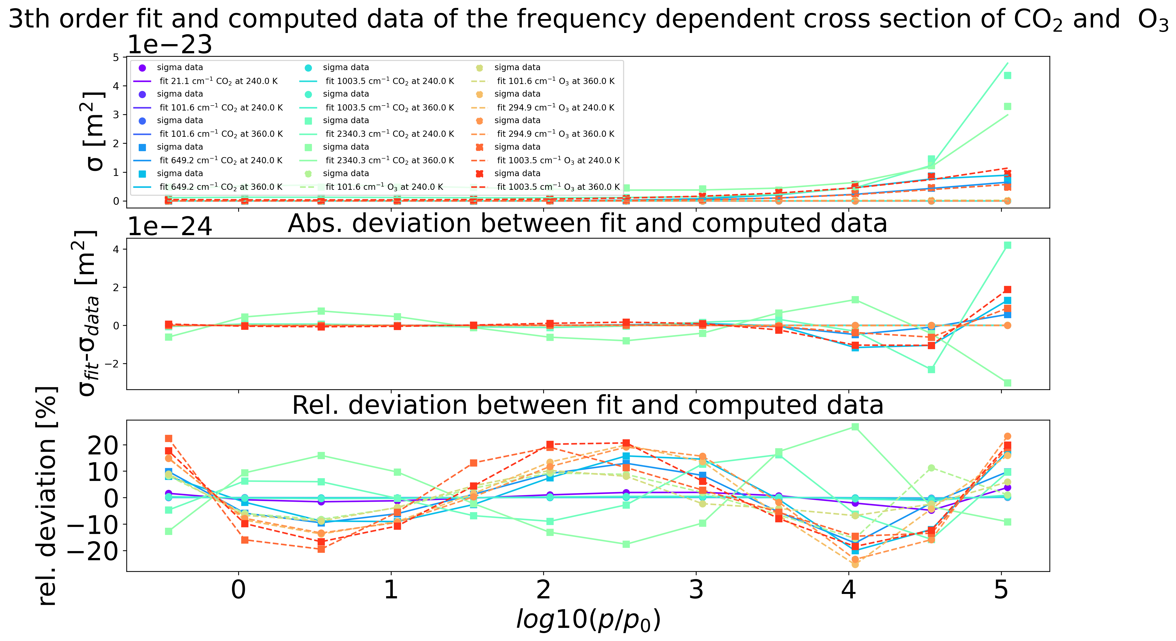
Cumulative cubic fitting with deviations for cross sections
all fits of ln(sigma) are plotted in same figure
Derived deviations fit-data for cross section additonally plotted
Design improved
Notes:
example for improved design: fit at frequencies at peak or wing of peak with square, far away of absorption peaks with circle plottted

Slide 4
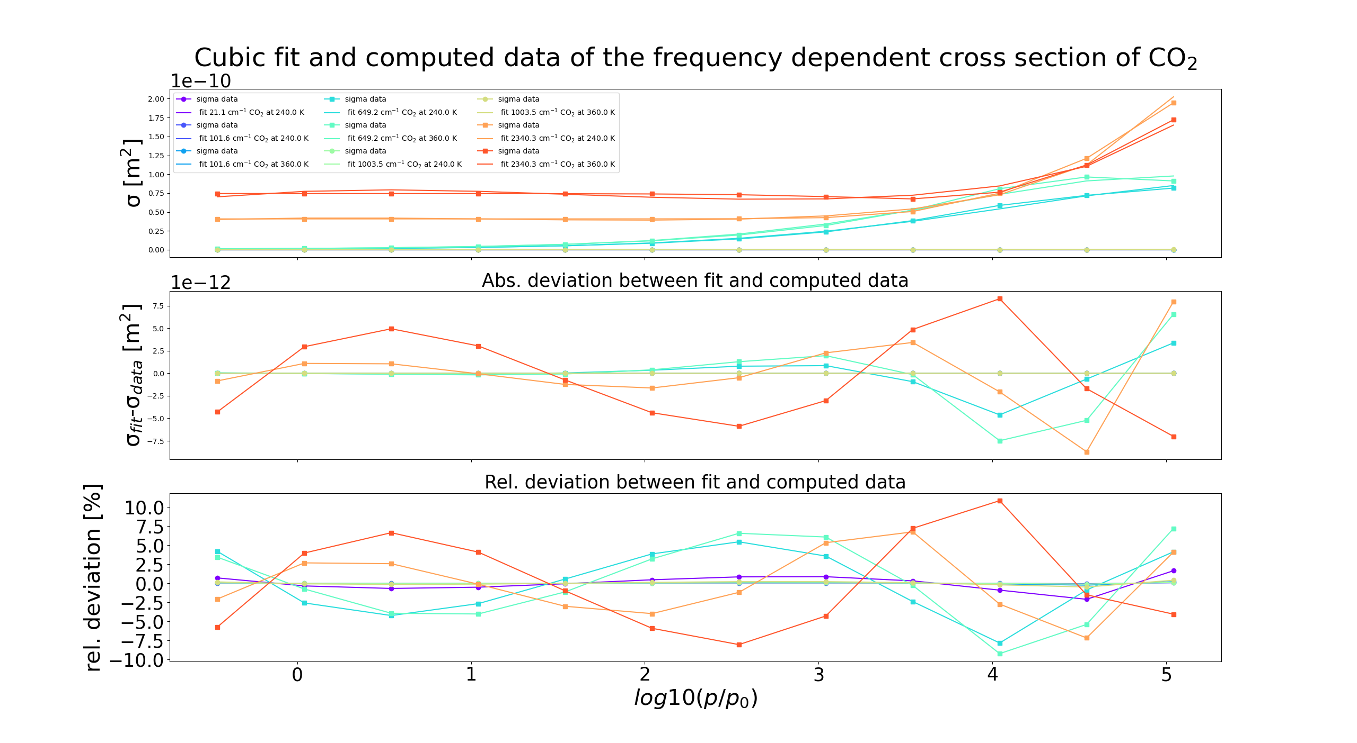
Cumulative cubic fitting with deviations for cross sections (CO2)
all fits of ln(sigma) are plotted in same figure
Derived deviations fit-data for cross section additonally plotted
Design improved
Notes:
example for improved design: fit at frequencies at peak or wing of peak with square, far away of absorption peaks with circle plottted

Slide 5
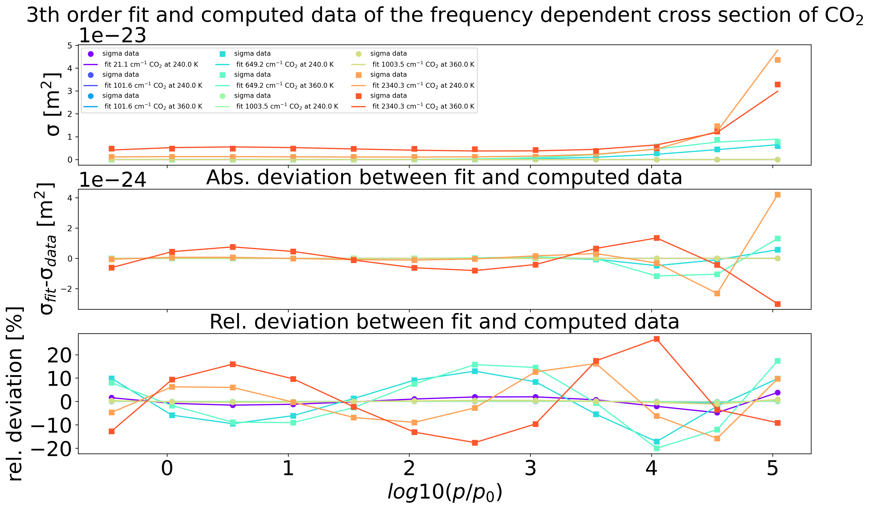
Cumulative cubic fitting with deviations for cross sections (CO2)
all fits of ln(sigma) are plotted in same figure
Derived deviations fit-data for cross section additonally plotted
Design improved
Notes:
example for improved design: fit at frequencies at peak or wing of peak with square, far away of absorption peaks with circle plottted

Slide 6
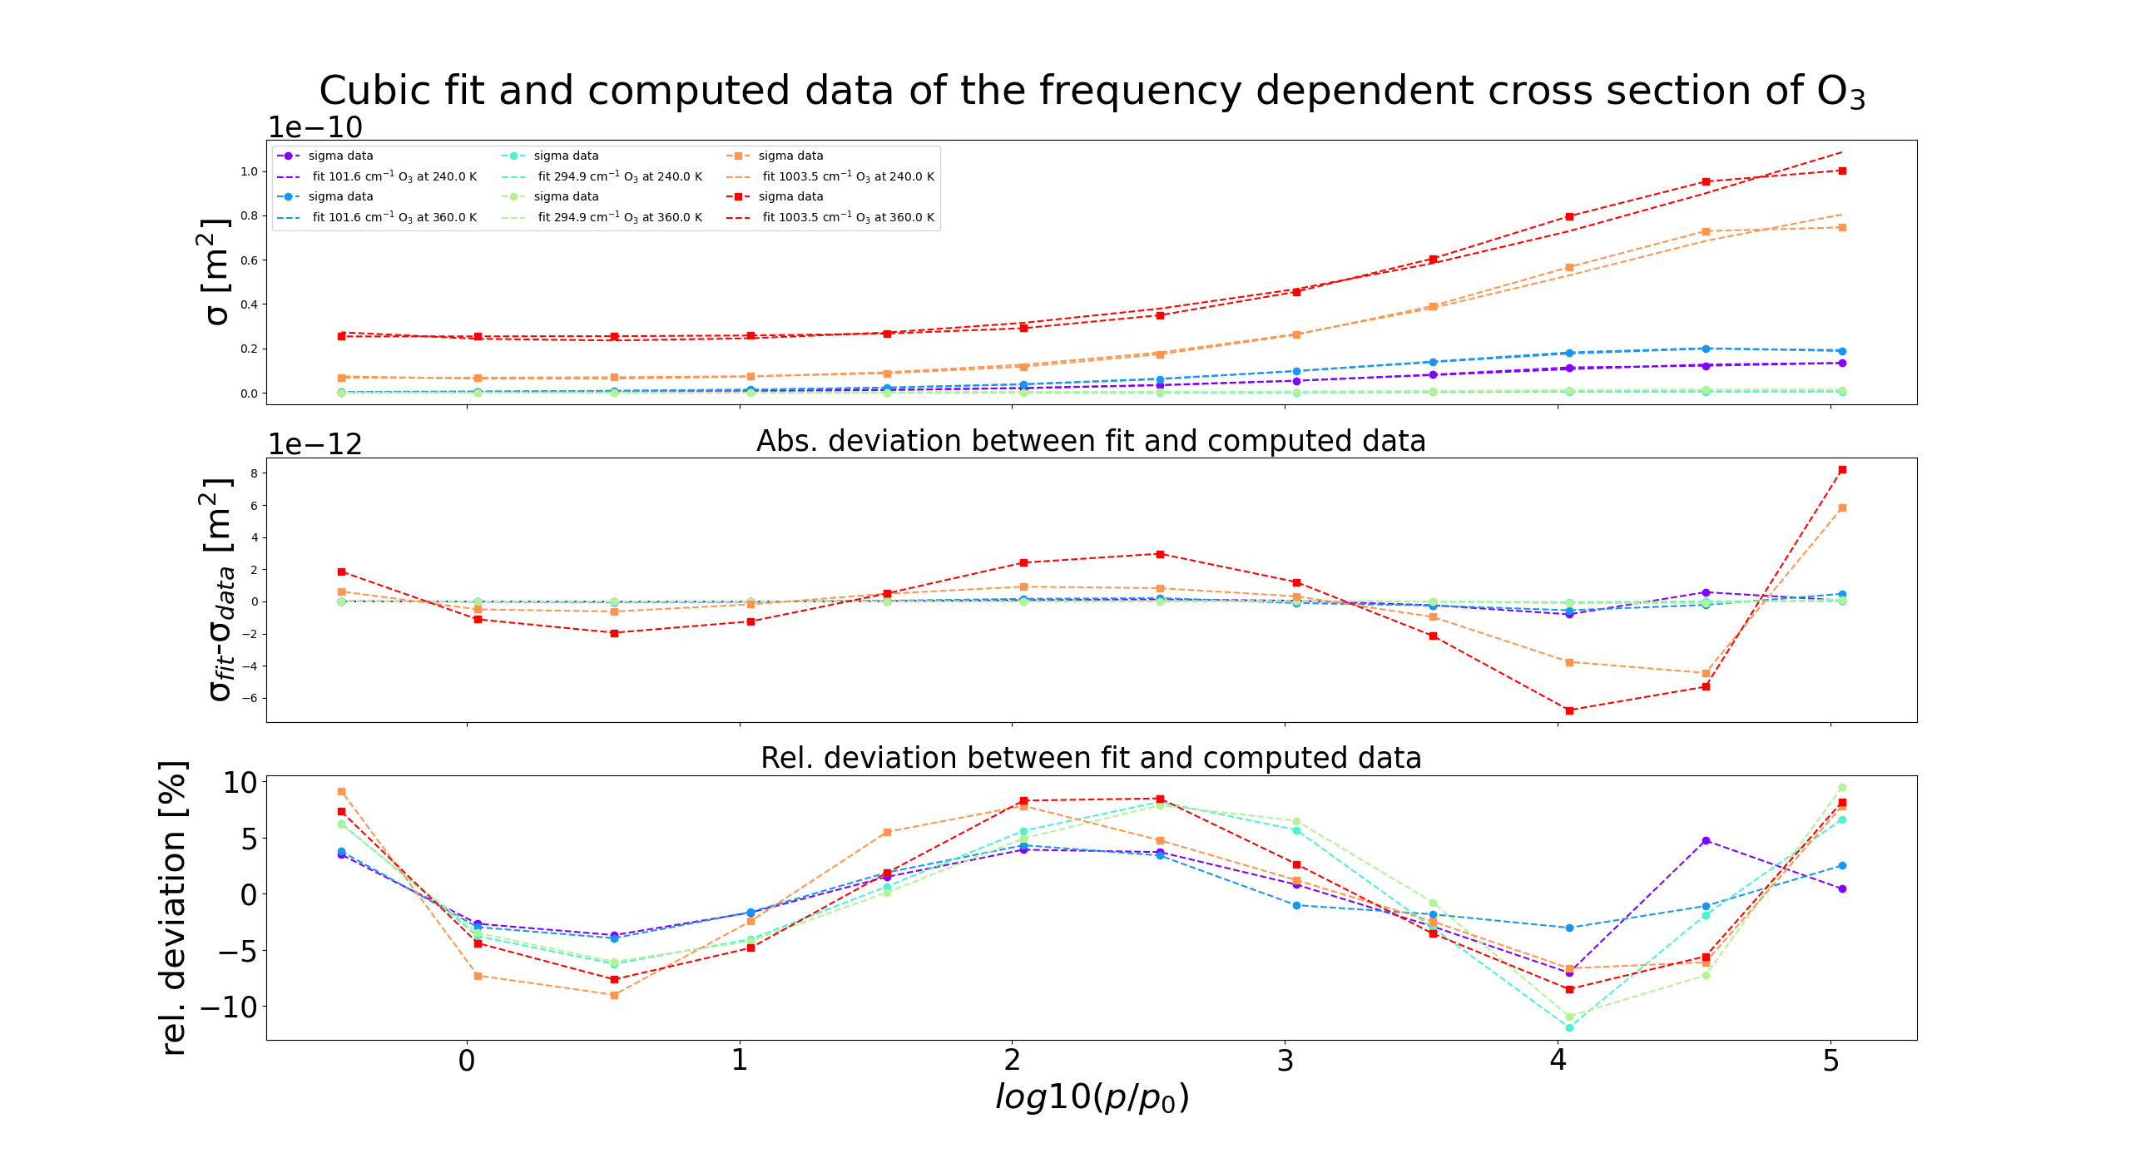
Cumulative cubic fitting with deviations for cross sections (O3)
all fits of ln(sigma) are plotted in same figure
Derived deviations fit-data for cross section additonally plotted
Design improved
Notes:
example for improved design: fit at frequencies at peak or wing of peak with square, far away of absorption peaks with circle plottted

Slide 7
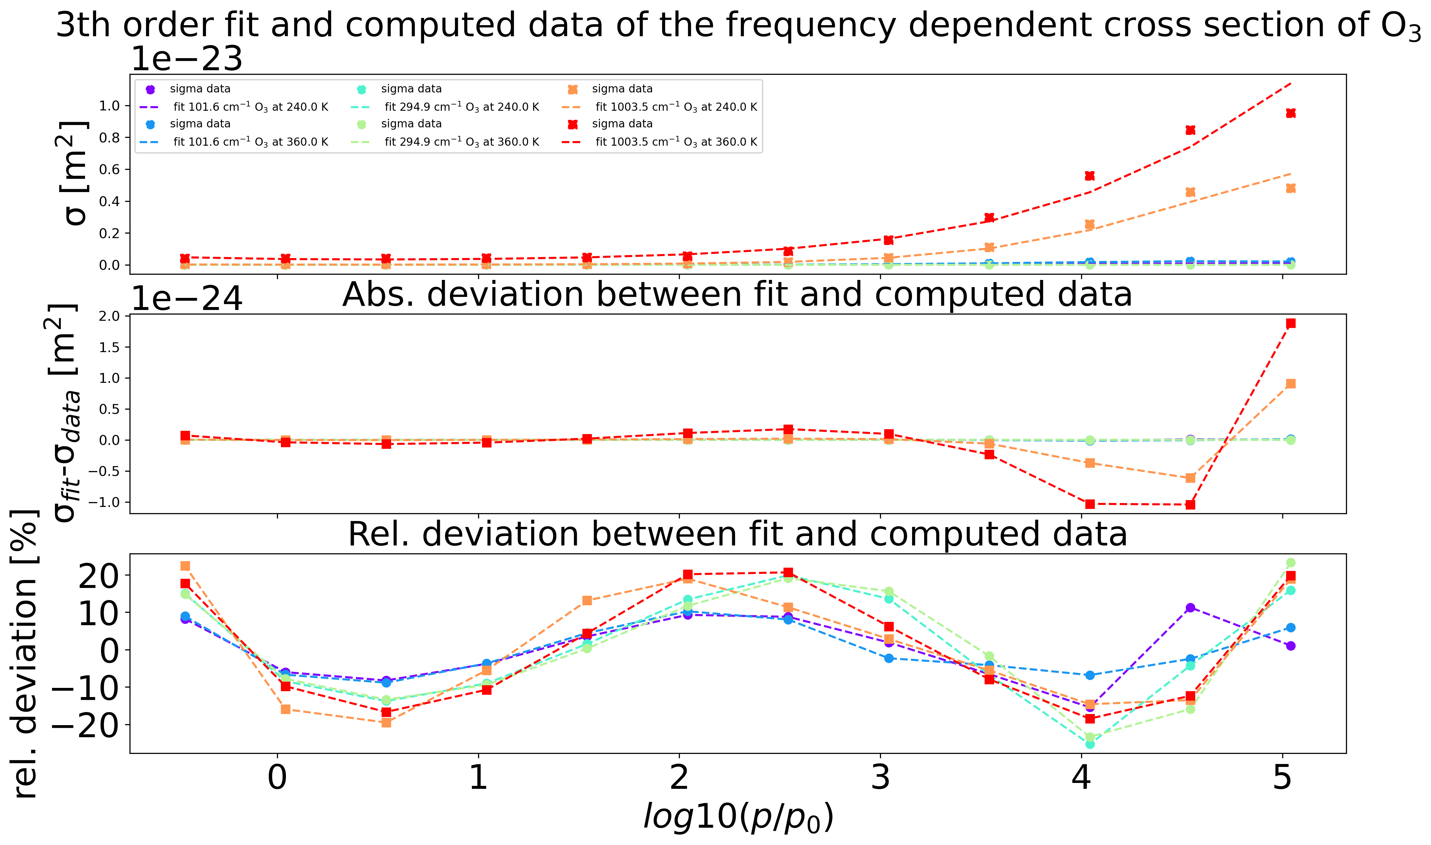
Cumulative cubic fitting with deviations for cross sections (O3)
all fits of ln(sigma) are plotted in same figure
Derived deviations fit-data for cross section additonally plotted
Design improved
Notes:
example for improved design: fit at frequencies at peak or wing of peak with square, far away of absorption peaks with circle plottted

Slide 8
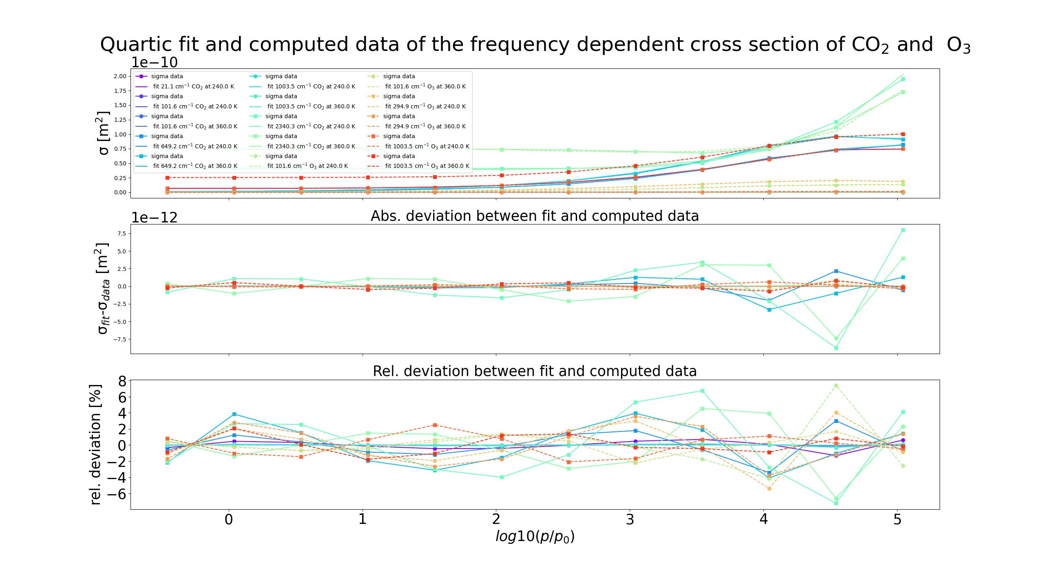
Fitting of ln(sigma) of higher orders- here quartic
Implemented polynomial cumulative fitting for general 1 dim polynomials
Purpose: reducing differences fit-data for cross sections to < 1%
Done until 8th order

Slide 9
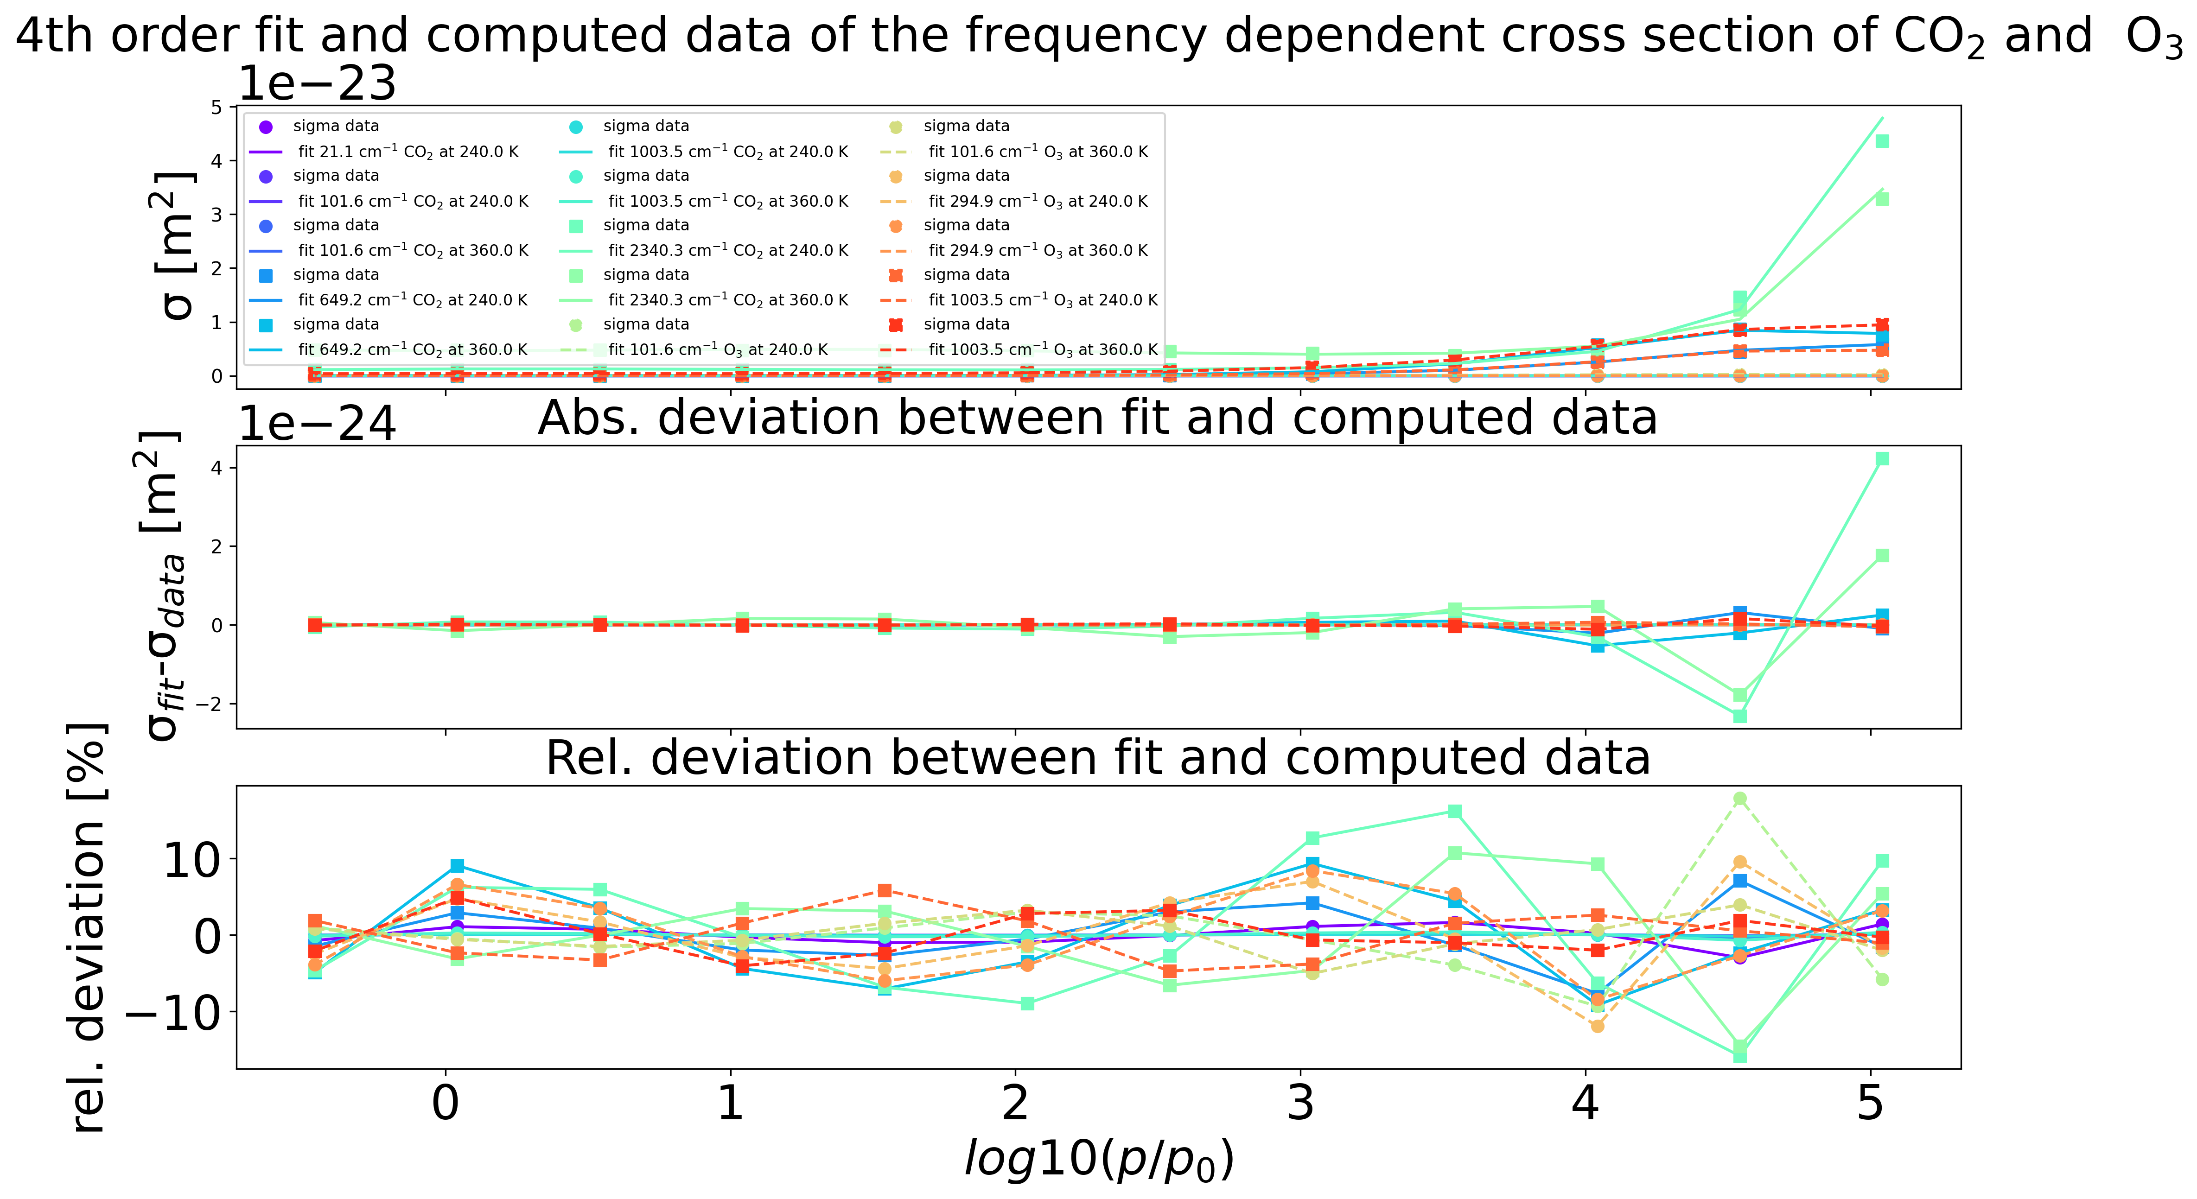
Fitting of ln(sigma) of higher orders- here quartic
Implemented polynomial cumulative fitting for general 1 dim polynomials
Purpose: reducing differences fit-data for cross sections to < 1%
Done until 8th order

Slide 10
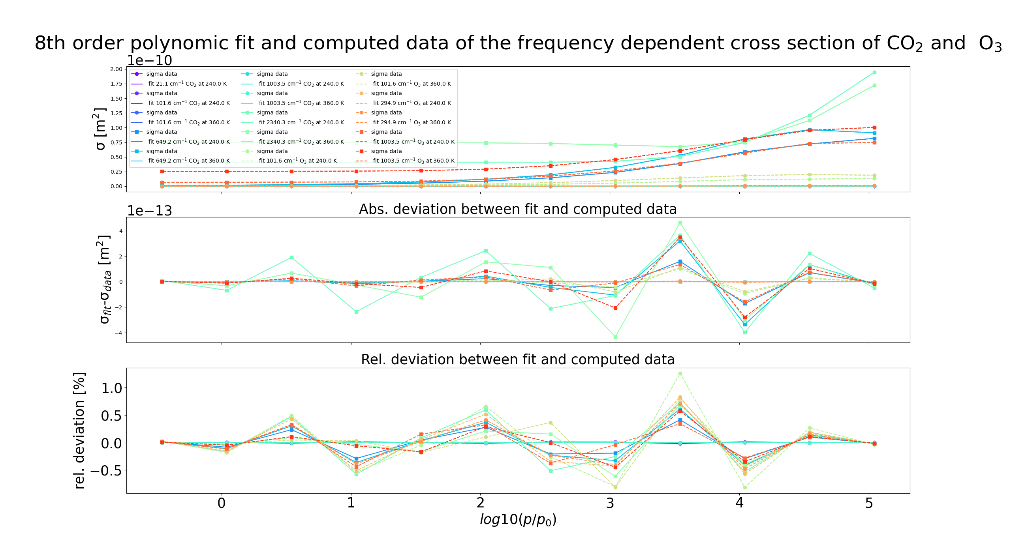
Fitting of ln(sigma) of 8th order
Maximal order of polynomial fitting is so far 8th order
There reaching maximal deviation fit-data for cross section around 1%
careful overfitting
➔ Shows in principle quite precise fittings are possible with polynomials of relatively low order are possible for only pressure fitting

Slide 11
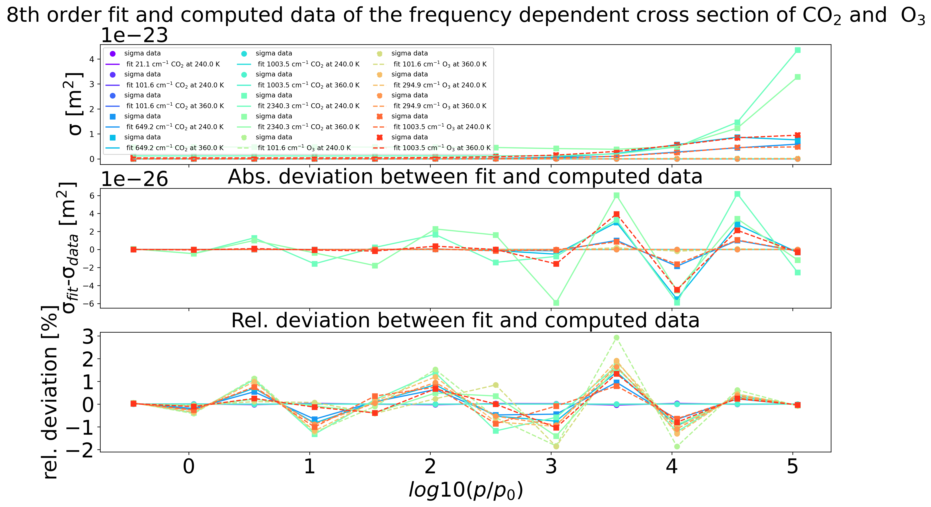
Fitting of ln(sigma) of 8th order
Maximal order of polynomial fitting is so far 8th order
There reaching maximal deviation fit-data for cross section around 1%
careful overfitting
➔ Shows in principle quite precise fittings are possible with polynomials of relatively low order are possible for only pressure fitting

Slide 12
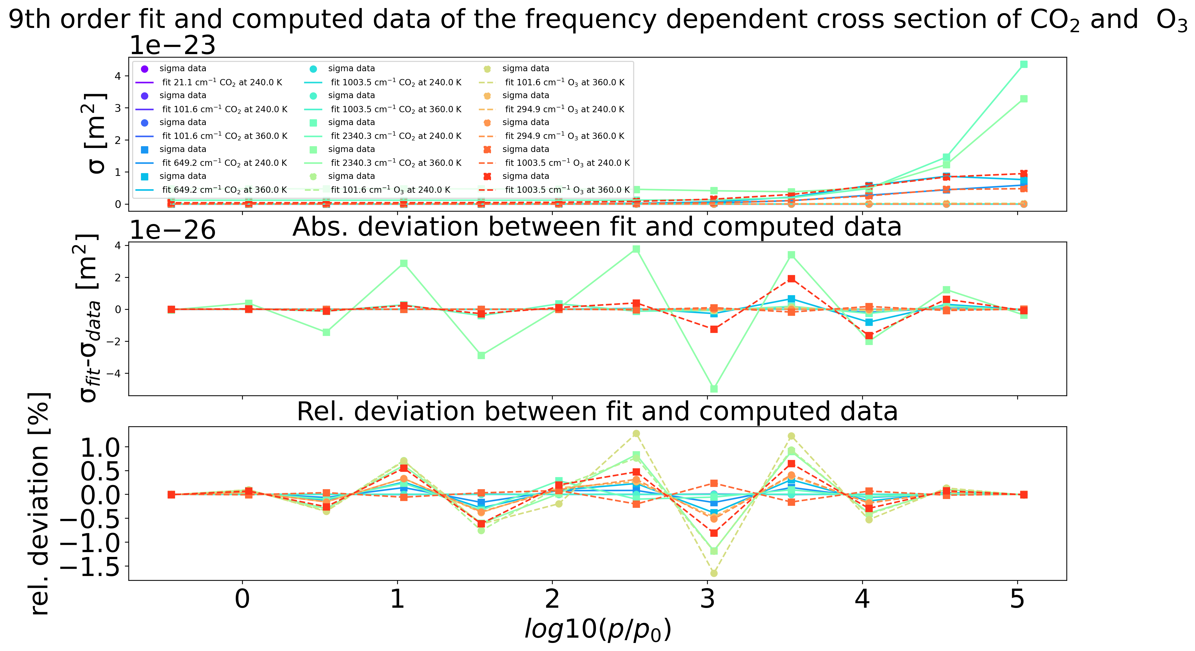
Fitting of ln(sigma) of 9th order
Maximal order of polynomial fitting is so far 9th order
There reaching maximal deviation fit-data for cross section around 1.5%
careful overfitting
➔ Shows in principle quite precise fittings are possible with polynomials of relatively low order are possible for only pressure fitting

Slide 13
Summary
Implemented one dimensional polynomial fitting for arbitrary orders and its fit-data deviations for cross sections
Studied for 1st to 8th order
For 8th order maximal deviation cross section fit-data of around 1% reached
➔ Shows in principle quite precise fittings are possible with polynomials of relatively low order are possible for only pressure fitting

Slide 14
Fitting of ln(sigma) of higher orders
Implemented polynomial cumulative fitting for general 1 dim polynomials for CO2
Purpose: reducing differences fit-data for cross sections to < 1%
Done until 8th order

Slide 15
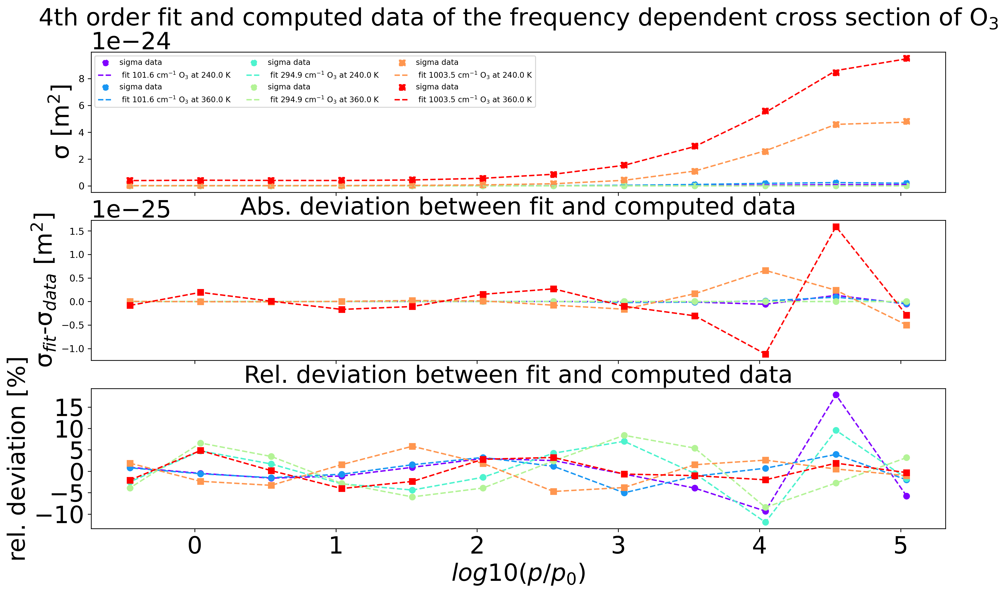
Fitting of ln(sigma) of higher orders
Implemented polynomial cumulative fitting for general 1 dim polynomials for O3
Purpose: reducing differences fit-data for cross sections to < 1%
Done until 8th order

Slide 16
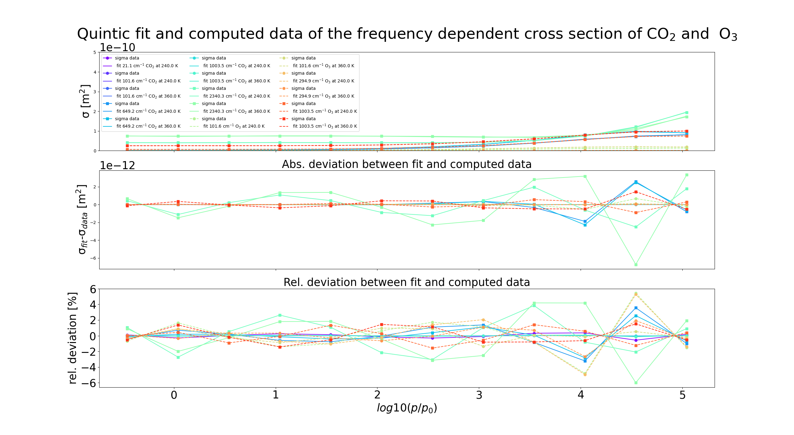
5th order Fitting of ln(sigma)

Slide 17
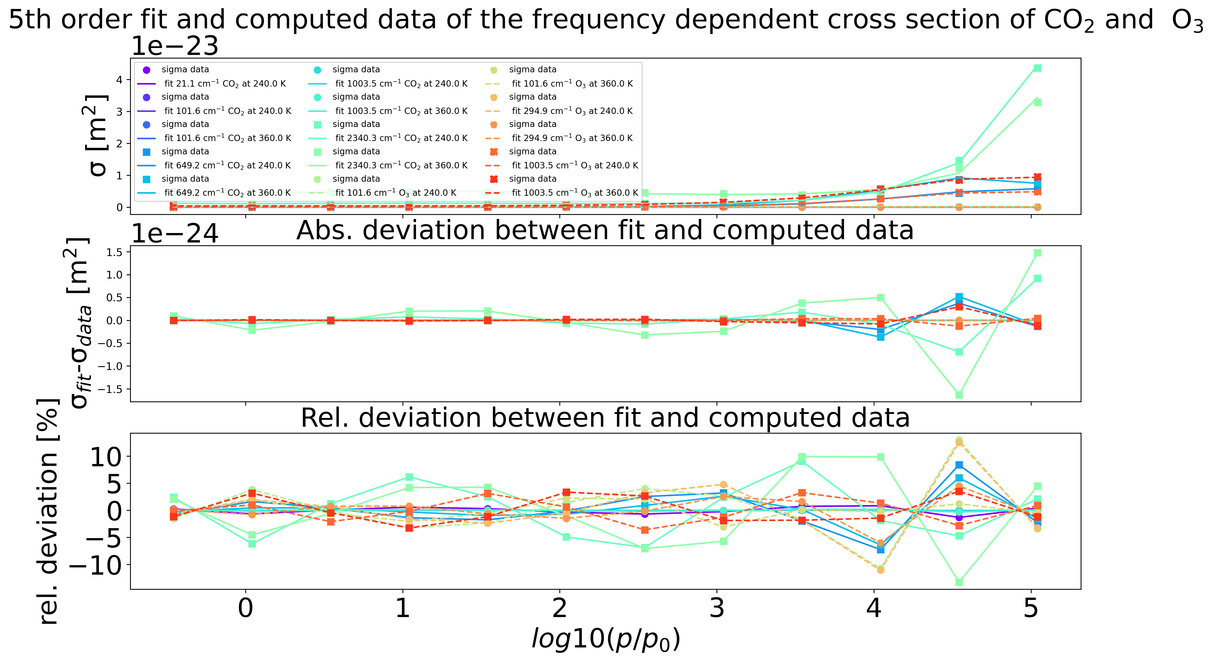
5th order Fitting of ln(sigma)

Slide 18
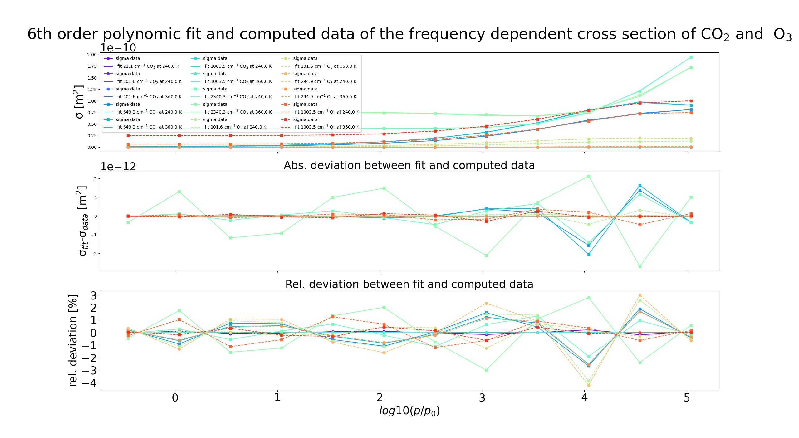
6th order fitting of ln(sigma)

Slide 19
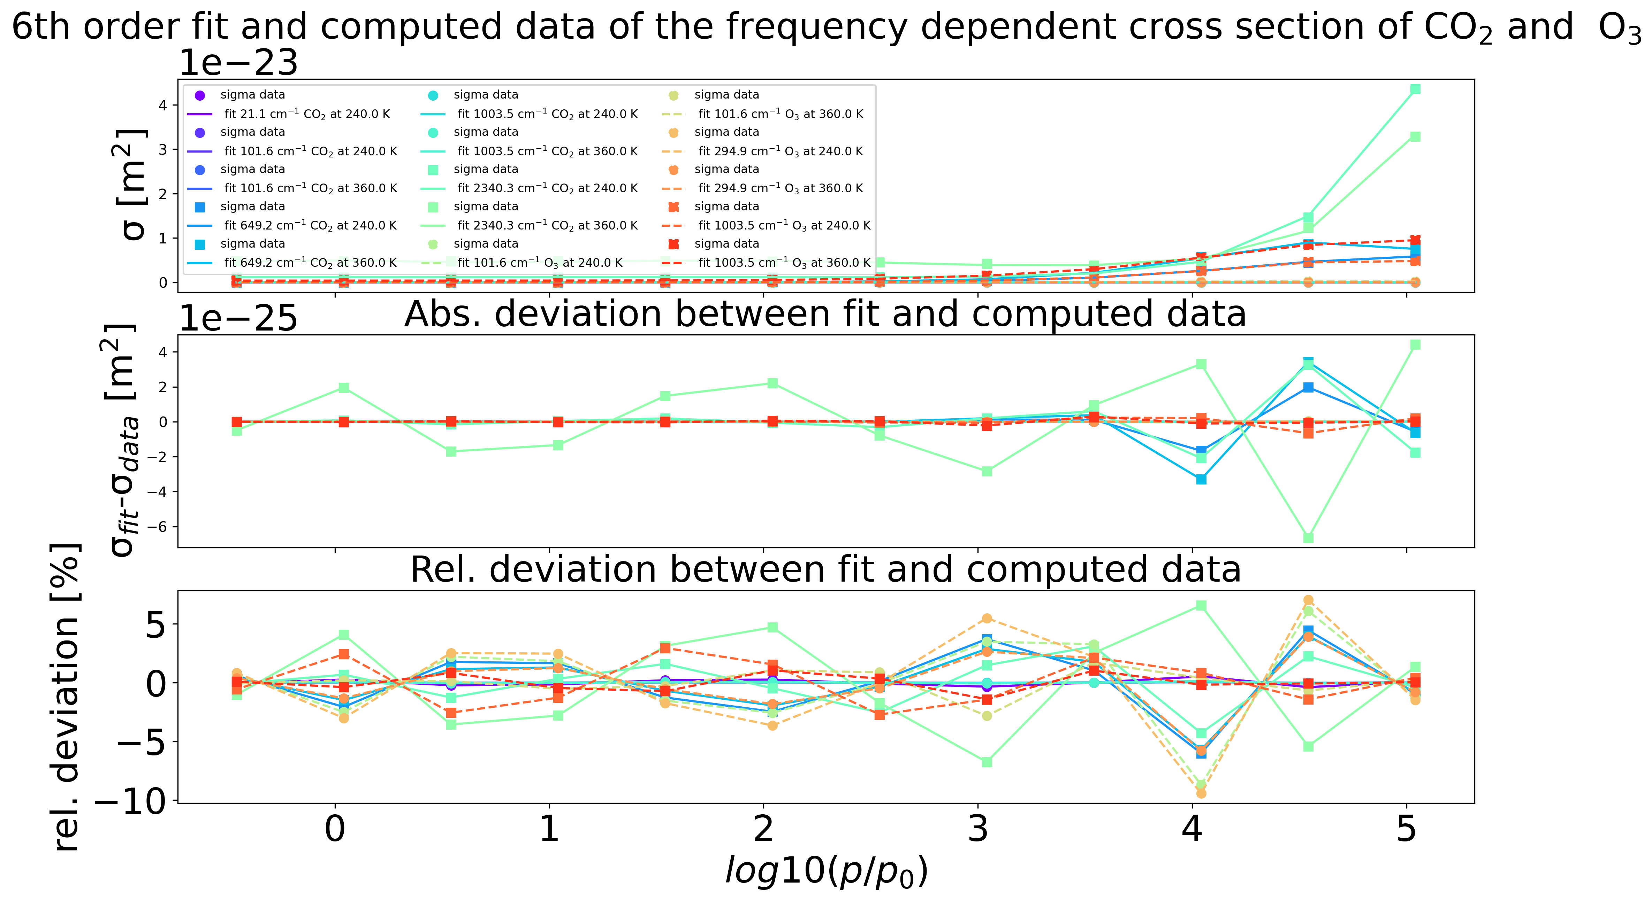
6th order fitting of ln(sigma)

Slide 20
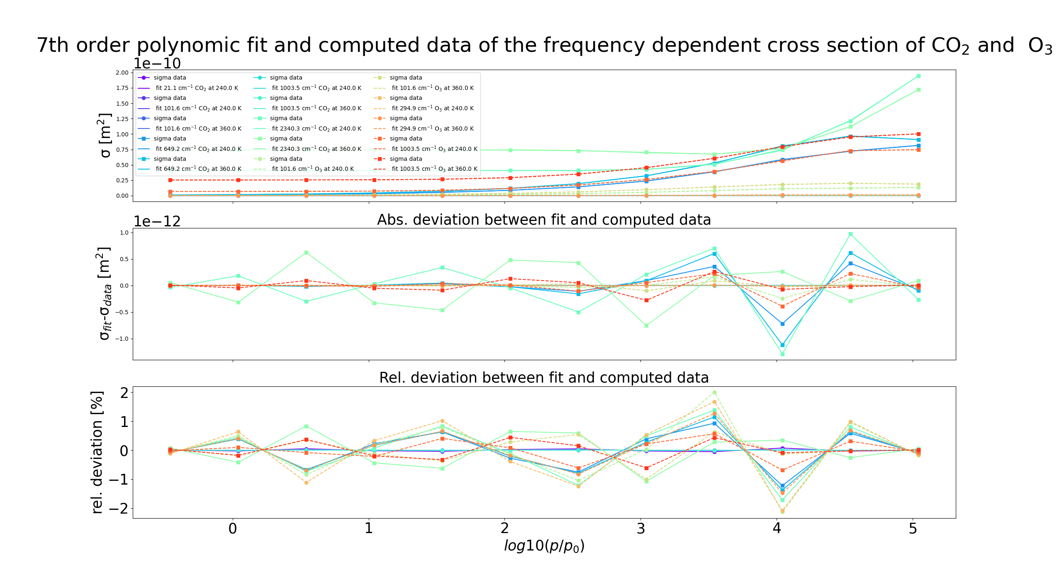
7th order fitting of ln(sigma)

Slide 21
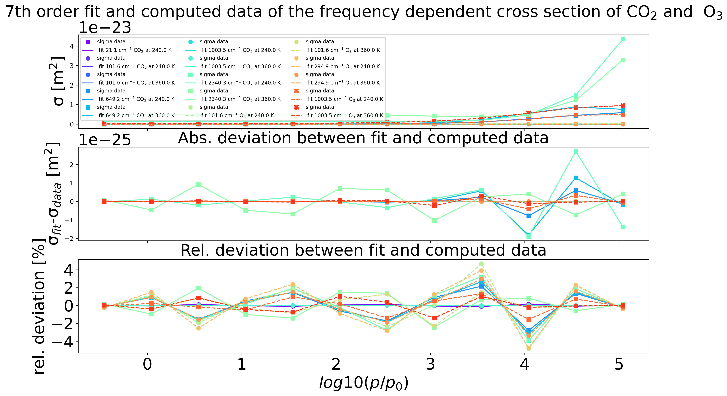
7th order fitting of ln(sigma)

Slide 22
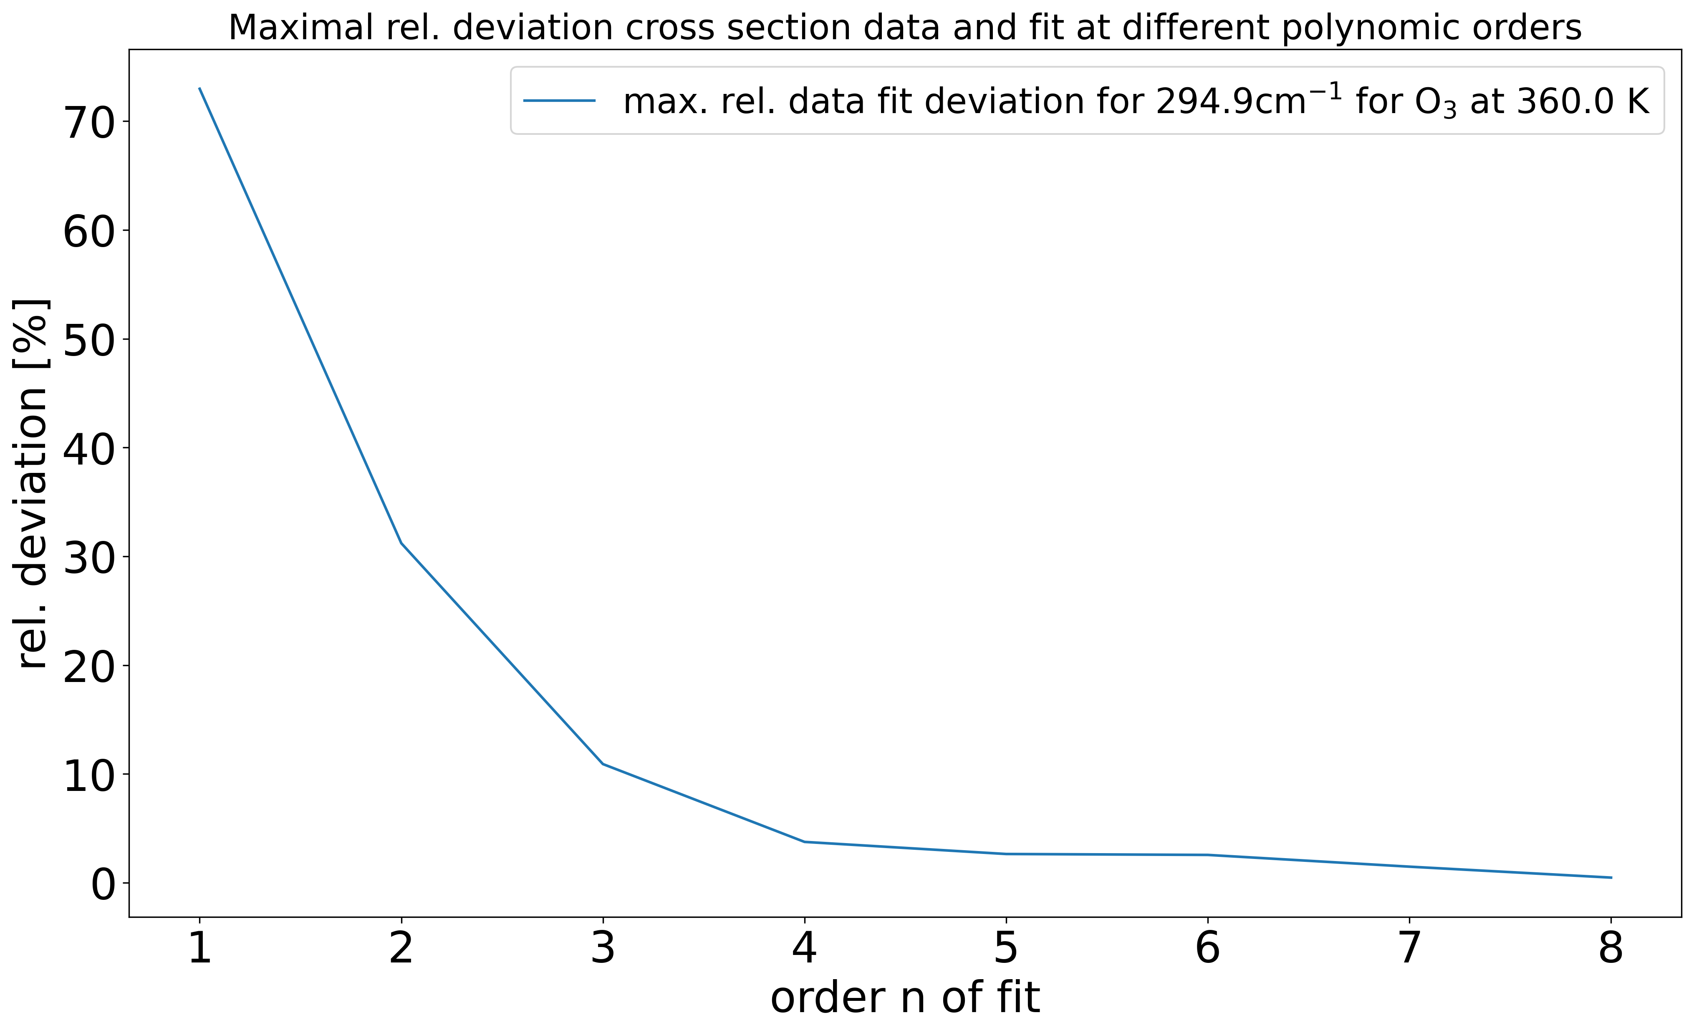
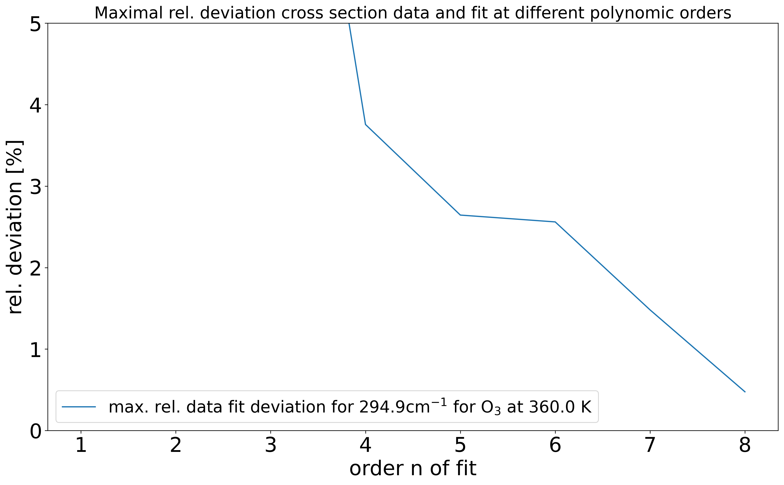
Order dependent maximal deviations
Plotted maximal devation fit- data for the polynomial fitting withpolynoms of different orders
Showed for the most challenging frequencies here for O₃
_{Frequency far away from peak}

Slide 23
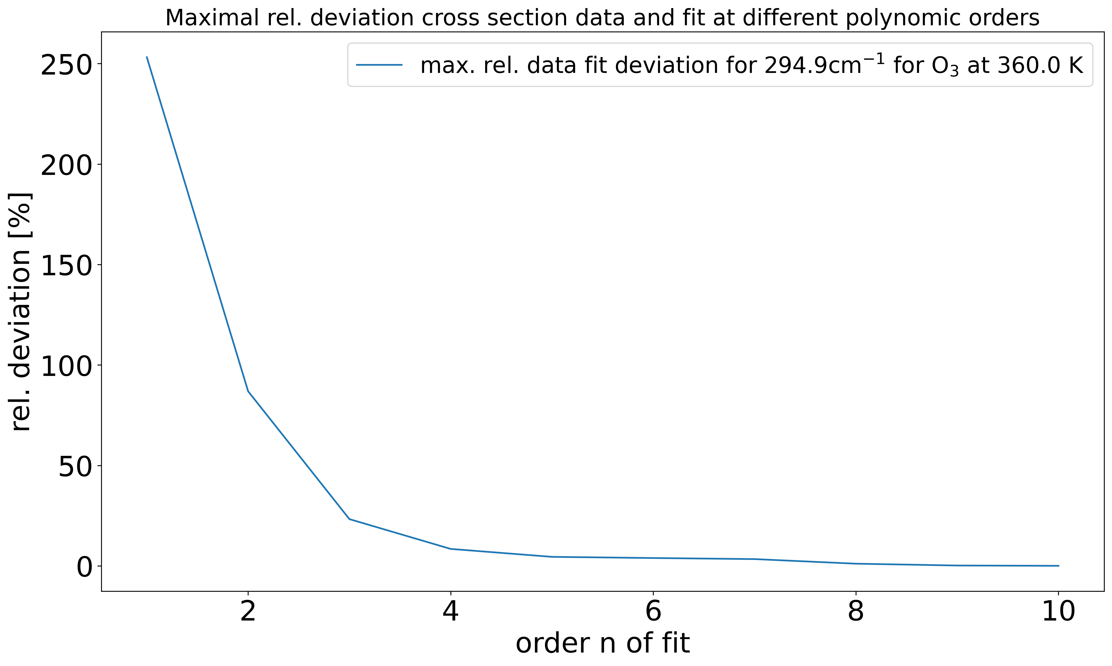
Order dependent maximal deviations
Plotted maximal devation fit- data for the polynomial fitting withpolynoms of different orders
Showed for the most challenging frequencies here for O₃
_{Frequency far away from peak}

Slide 24
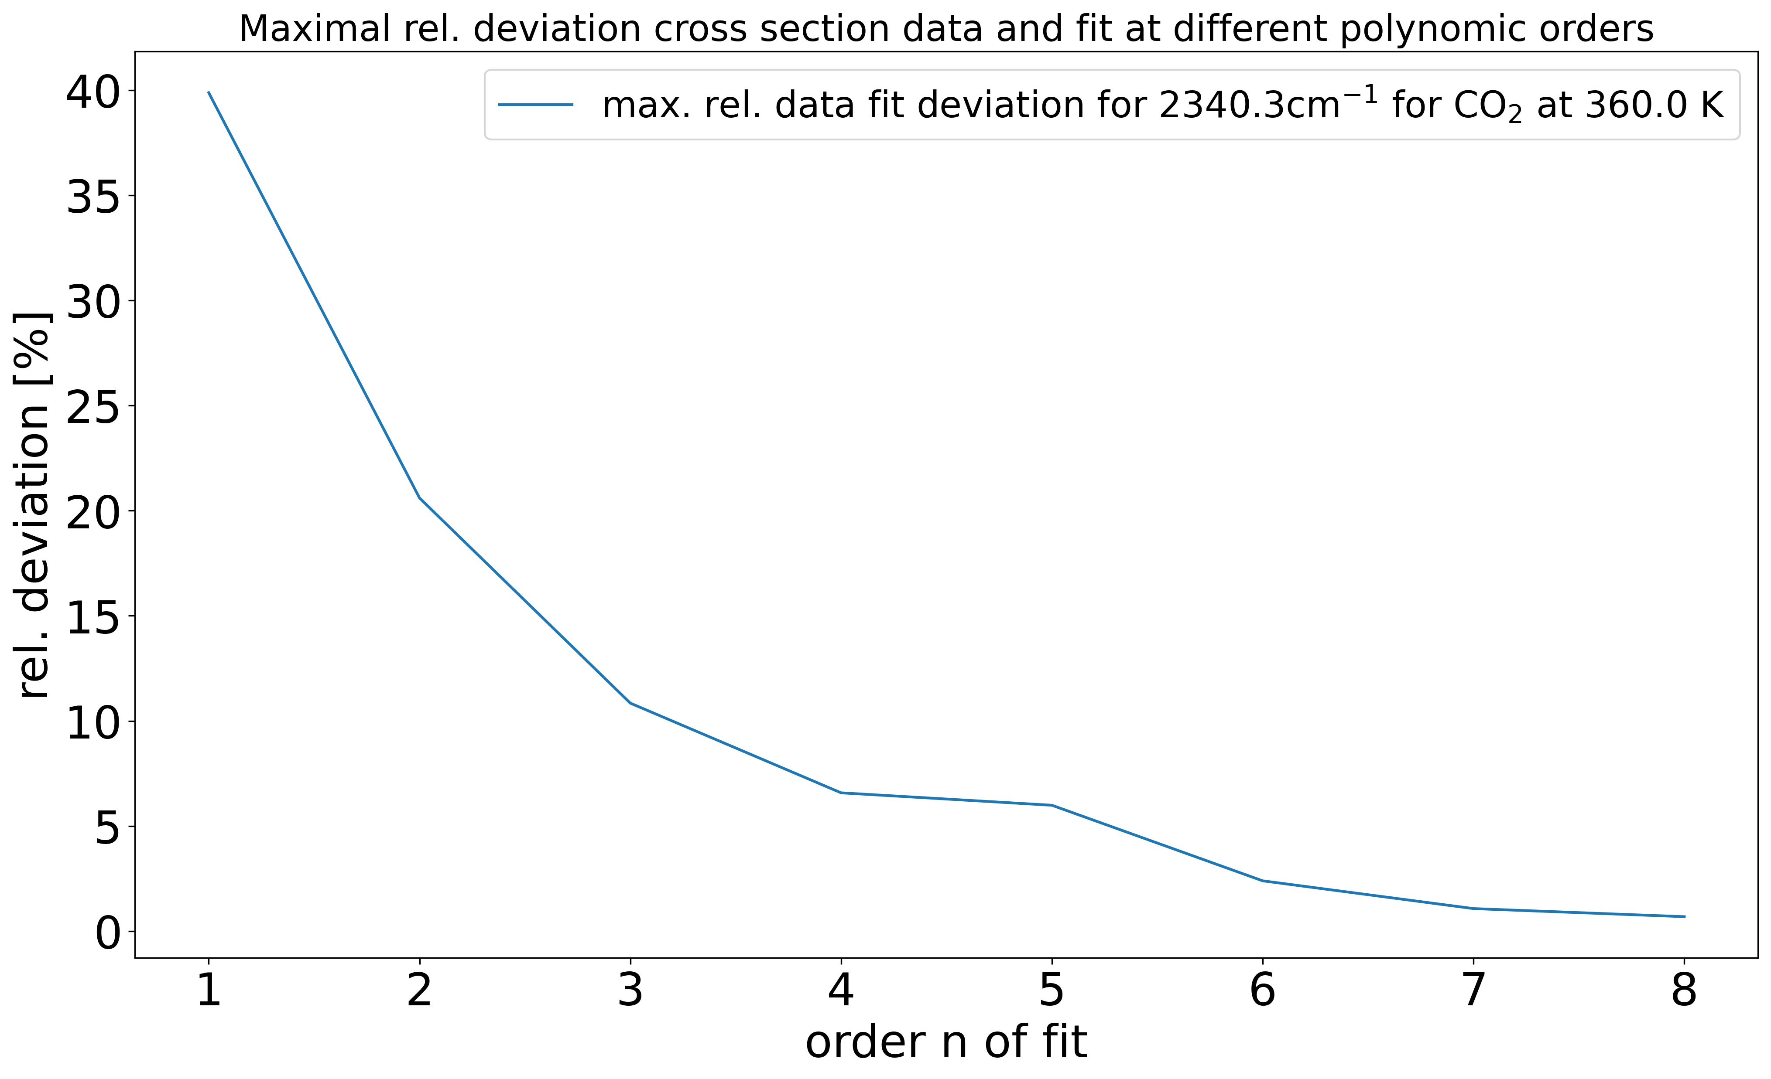
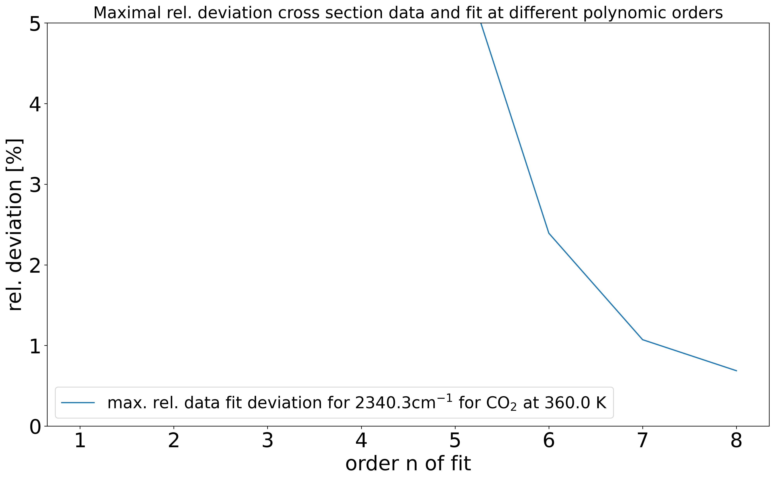
Order dependent maximal deviations
Plotted maximal deviation fit- data for the polynomial fitting with polynoms of different orders
Showed for the most challenging frequencies here for CO₂
_{Frequency near peak}

Slide 25
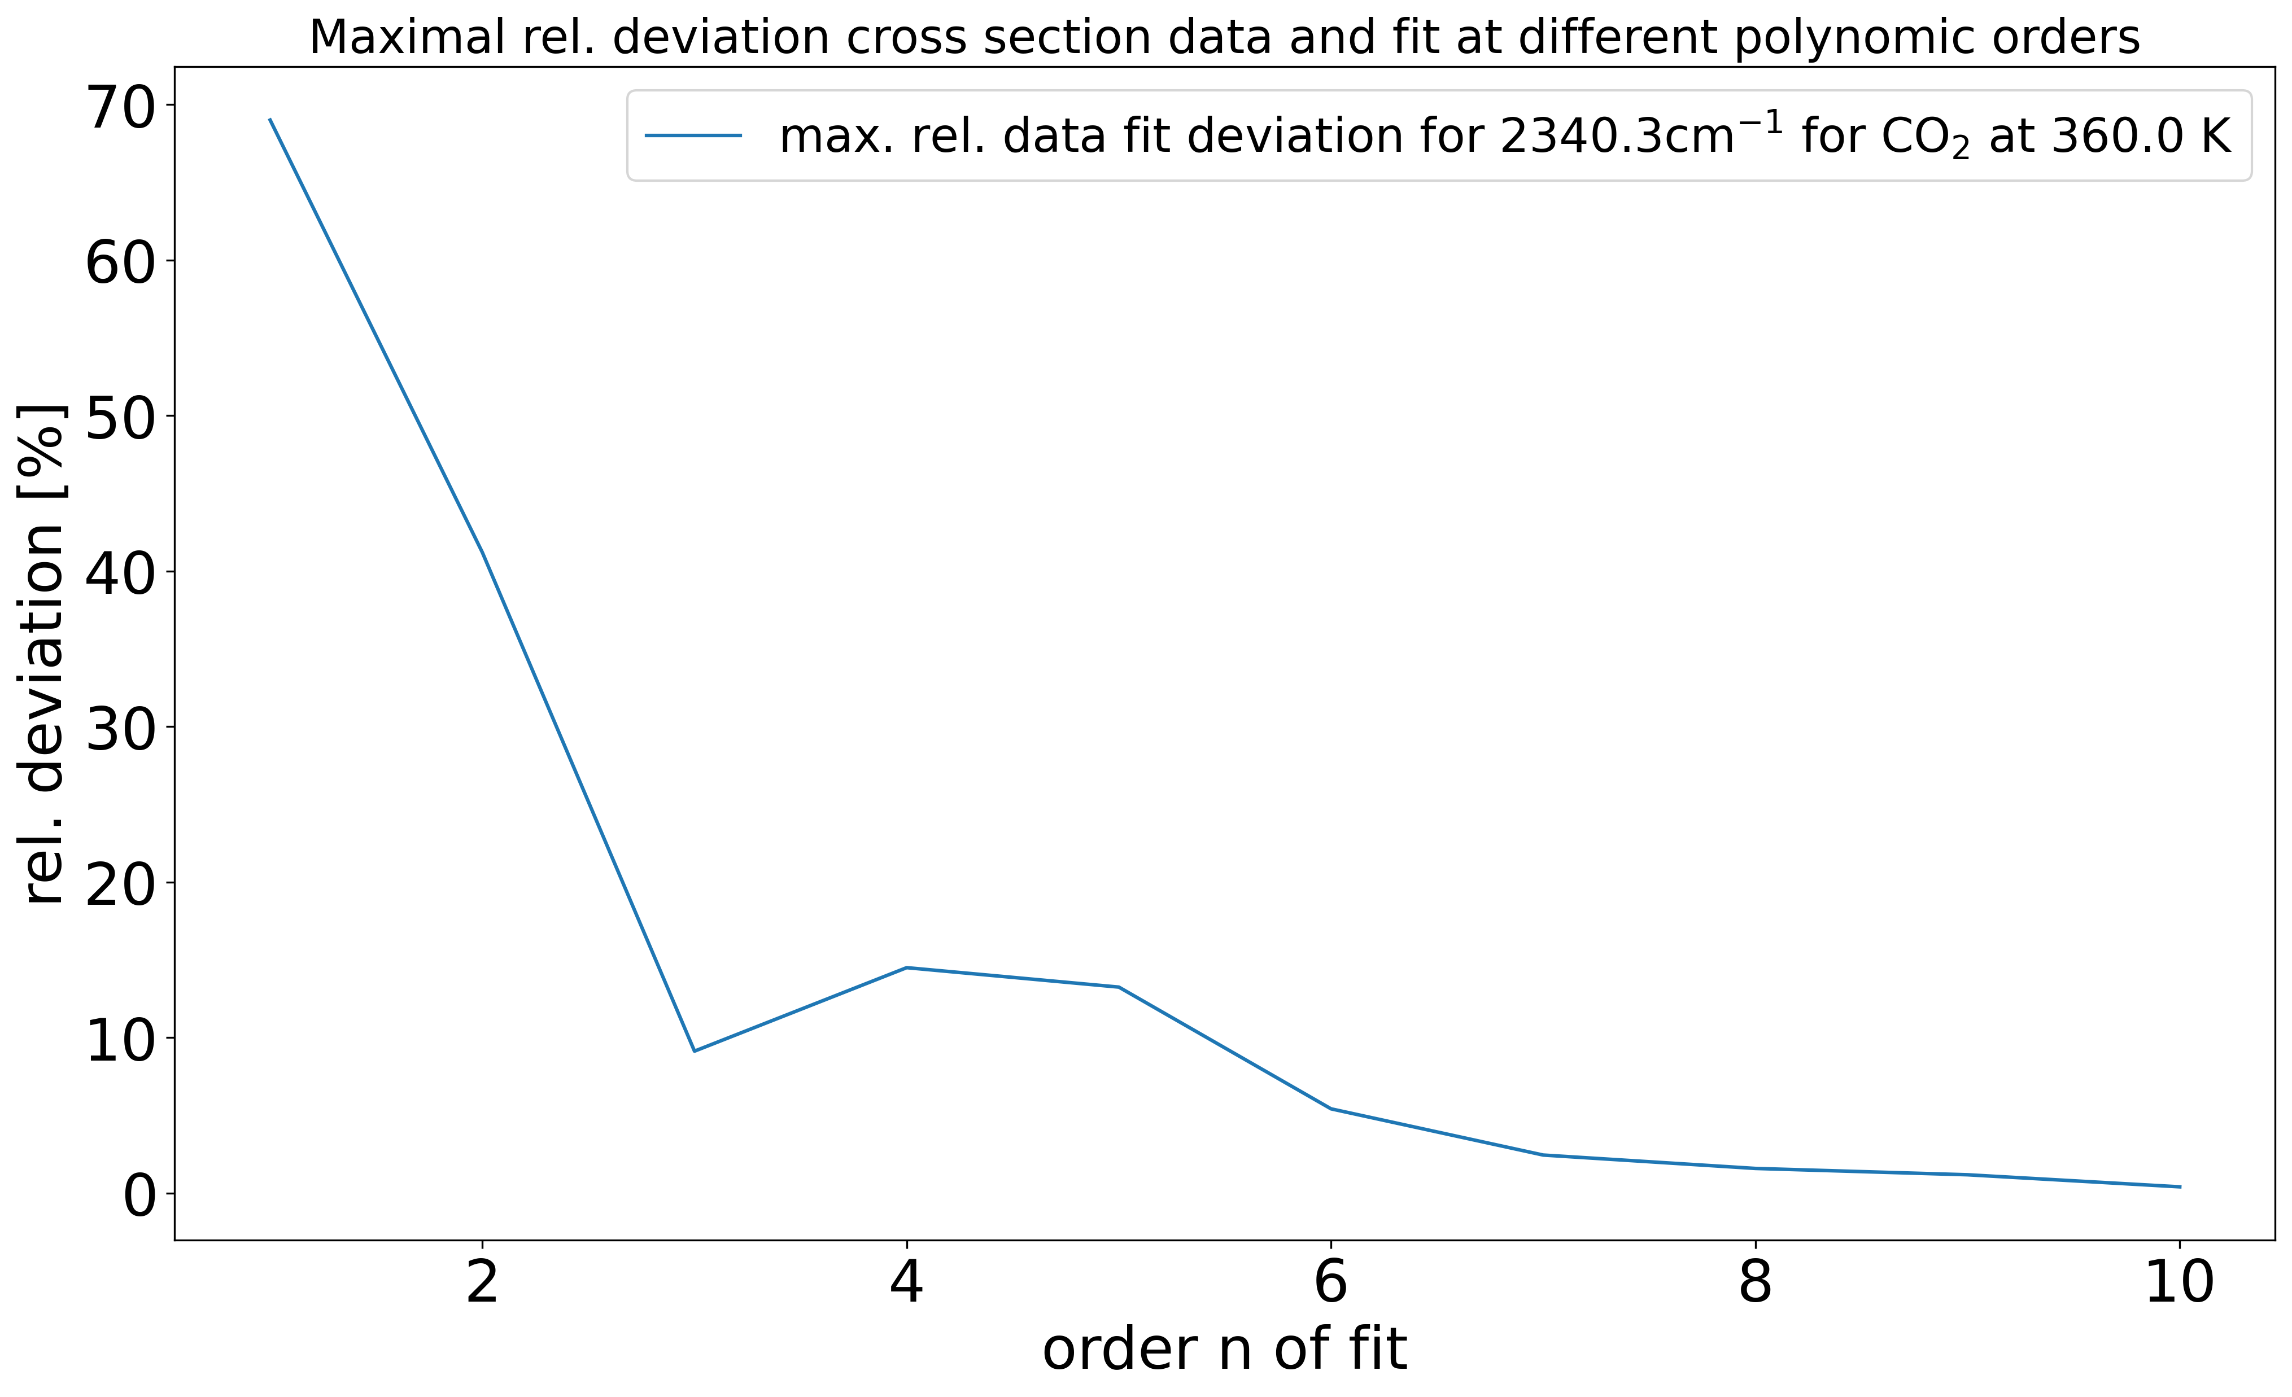
Order dependent maximal deviations
Plotted maximal deviation fit- data for the polynomial fitting with polynoms of different orders
Showed for the most challenging frequencies here for CO₂
_{Frequency near peak}
Fast decreasing until 4 th order, than more slowly

